Slide 1
5G MC-RTT + AoA Positioning Testing Proposal
Feb. 4, 2022

Slide 2
Trial Phases - Recap
Phase | Location | Description | Comments
Phase 1 | RAN vendor campus | UE-Assisted MC-RTT + AOA | Goal: demonstrate raw potential of 5G-NR for positioning in automotive environment under multipath Limited to infra vendor's campus coverage No involvement from carrier Timeframe: 1Q’22 pending joint agreement
Phase 2 | Commercial NW | UE-Assisted MC-RTT + AOA | Goal: demonstrate raw potential of 5G-NR for positioning in automotive environment under multipath in commercial network Limited carrier commercial NW coverage Timeframe: TBD
Phase 3 | Commercial NW | UE-Based Loosely coupled GNSS + sensors + MC-RTT + AOA + ML | Goal: demonstrate potential of 5G-NR to improve raw GNSS + sensors performance in automotive environment under multipath in commercial network Limited carrier commercial NW coverage Timeframe: Phase 2 completion + 1Q
Phase 4 | Commercial NW | UE-Based Tightly coupled GNSS + sensors + DL-TDOA + DL-AOD + ML | Goal: demonstrate potential of Fusion of 5G-NR/GNSS/sensors to meet commercial requirements across typical automotive environments Limited carrier commercial NW coverage Timeframe: 3Q’23

Slide 3
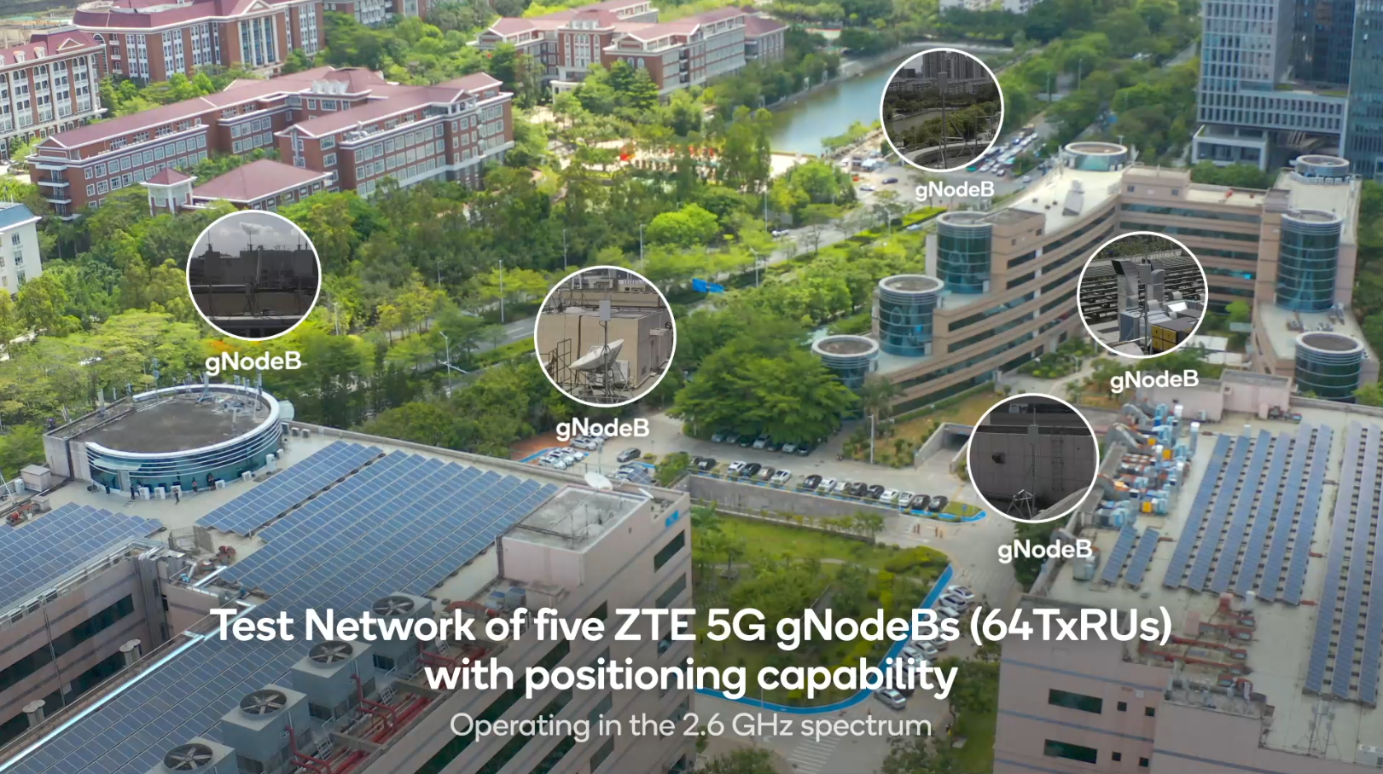
Phase 1 Test
5G NR positioning in automotive multipath environment
Location : infra vendor's Shenzhen campus
Band: n41 (2.6GHz)
Bandwidth : 100MHz
Infra vendor's gNBs
  5 gNBs operating in SA mode
  64 TxRUs with positioning capability on each gNB
  30-40 meters above the ground
  Tx power: 200W
Qualcomm UE
  SDX60 MTP supporting up to 16 cells simultaneously for positioning
Qualcomm location server
  QPoint – designed and operated by Qualcomm
4
1
3
5
2

Slide 4
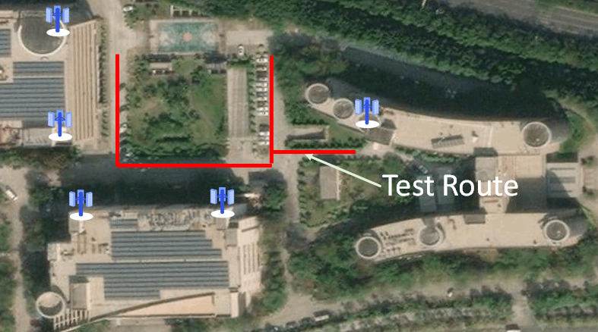
Phase 1 Test
Trial network in Infra vendor's Shenzhen Campus
gNB configuration and downtilt
gNB1 (PCI 1): 10.3 degrees
gNB2 (PCI 2), 7.9 degrees
gNB3 (PCI 993), 18 degrees
gNB4 (PCI 996), 21.5 degrees
gNB5 (PCI 90), 20.5 degrees

Slide 5
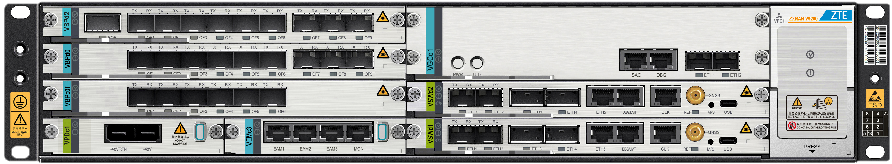

Phase 2/3/4 Test
Option1
LBS
In Carrier's Limited Commercial or Trial Network
NodeEngine
Proposed Trial Location
  Alt1: Shanghai
  Alt2: Beijing
Requirements for the selected test area
    Includes >= 20 cell sites (>= ~60 individual cells)
    Region with infra vendor's infra nodes
    Region amenable to drive testing
    If a portion of commercial network is chosen, flexibility to bring in test gNBs during off peak hours
Location server solutions
  Option1: Qualcomm QPoint solution in carrier's commercial/trial network
    Solution is already validated with infra vendor's gNB and Qualcomm UE; readily available
    Need approval from carrier/infra vendor
  Option2: infra vendor's LMF in carrier's commercial/trial network
    Timeframe TBD (no earlier than late 2022), QC-infra vendor IODT not yet completed
VGCd1
QPoint Laptop
5G NR
5G NR
5G NR
QC SDX60 MTP
Option2
LMF
NodeEngine
VGCd1
5G NR
5G NR
5G NR
QC SDX65 MTP

Slide 6
Reference Signal Configuration
PRS
  Periodicity： 160ms
  # of Slots： 1 slot
  # of symbols per slot： 2 symbol
  Comb： comb2
SRS for positioning
  Periodicity： 160ms
  Slots： 1 slot
  # of symbols per slot： 2 symbol
  Comb： comb4

